Slide 1
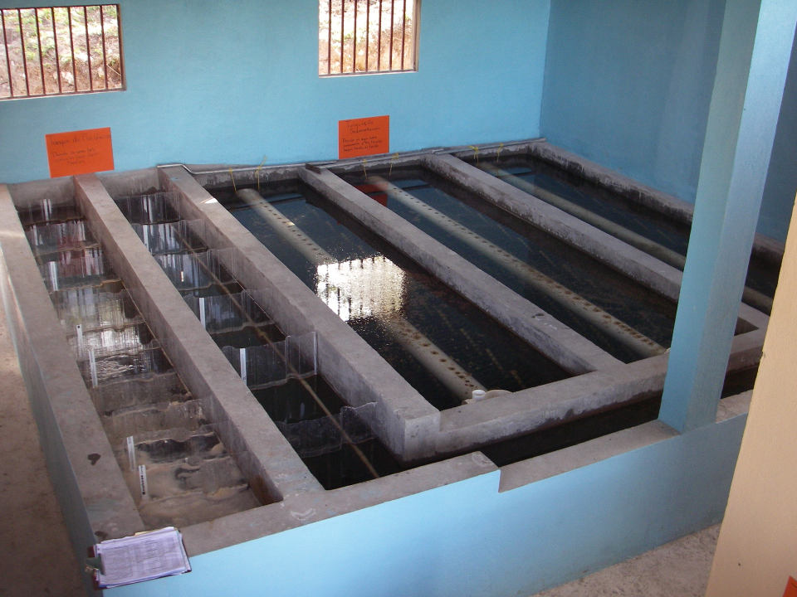
Flocculation Models

Slide 2
Capturing the mean behavior
The floc size distribution of the suspension entering the floc blanket is determined by the velocity gradient in the flocculator
These flocs grow to the size set by the velocity gradient in the floc blanket
The concentration of actively growing flocs in the floc blanket is set by the constraint that it must be sufficient to provide the collisions needed to transform the flocculator flocs into floc blanket flocs

Slide 3
The number of sequential collisions required to convert flocculator flocs into floc blanket flocs determines the removal efficiency of residual turbidity
Do the flocculator flocs grow by doubling (plug flow model – the only flocs nearby are of the same size)?
Do the floc blanket flocs form by sequentially colliding with flocculator flocs? (this would be the case if

Slide 4
Fractals capture the idea that volume isn’t conserved
What happens to the density of a floc as it grows larger?
Floc density approaches the density of water because the floc includes water
diameter of primary particle
diameter of floc
Fractal dimension
Number of primary particles in the floc
3
If volume were conserved, what would D_{Fractal} be? ____
Is floc mass conserved? _____
No!

Slide 5
Particle separation length scale (Λ)
The average volume of water “occupied” by a particle is = to the inverse of number of particles per volume (n_{P})
The number of flocs decreases as the flocs grow in size

Slide 6
Comparison of classic and hypothesized collision models
Classic model: transport and mixing at length scales larger than the diameter of the particle do not influence collisions – therefore slow, long, straight walk toward a collision
Hypothesized model: fast random walk clearing volume of fluid equal to volume occupied followed by slow, short, straight walk toward a collision*
* Edge of knowledge

Slide 7
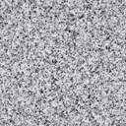
Relative velocity scales with diameter

Slide 8
Relative velocity scales with separation distance
Target

Slide 9
Model assumption differences are about the relative velocities
Classic particle collision models assume that the average relative velocity of two particles is set by the length scale of the diameter of the particles regardless of their separation distance
We hypothesize that the majority of the transport time is spent in a long random walk with relative velocities based on the average particle separation distance (Λ)*
* Edge of knowledge

Slide 10
Proposed (Λ) Long Range Transport Hypothesis*
At all times there exists a differential VOLUME of fluid that will transport any particle with its center located within that differential VOLUME to a collision of the particle and collector between and
The time required for that final transport to a collision is
Long range transport delivers the particle to the differential volume for the final slow transport to the collision
* Edge of knowledge

Slide 11
How much water is cleared (filtered) from a floc’s perspective?
Volume cleared is proportional to a collision area defined by a circle with diameter = sum of the floc diameters
Volume cleared is proportional to time
Volume cleared is proportional to the relative velocity between flocs

Slide 12
Collisions between flocs of very different sizes
Collision area for dissimilar sized flocs is pi*D1*D2
Collision area for similar sized flocs is pi*D1^2
So collision ratio is D2/D1
Thus if D2 sized flocs are growing larger at that rate that they are being imported into the floc blanket, then D1 sized flocs are being swept along at a rate of D1/D2

Slide 13
Use dimensional analysis to get a relative velocity
Velocity scales with
L is separation distance
Assume linear velocity gradient
Velocity gradient
dimensions
Notes:
The length scale is the average separation distance of the flocs

Slide 14
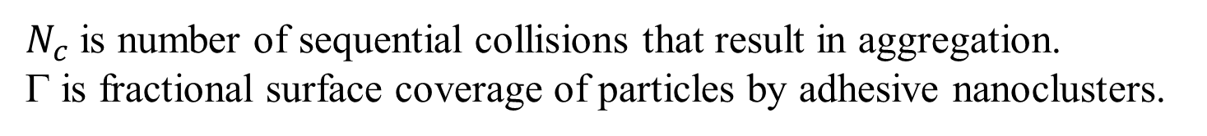
Collision rates for the two assumptions
t_{c} is average time per collision
Relative velocity
Time for one collision
$N_{c}$ is number of sequential collisions that result in aggregation.
Γ is fractional surface coverage of particles by adhesive nanoclusters.
Notes:
Find the time to clear the volume occupied by one floc.
Then we need to find the average relative velocity of the two flocs based on their average separation distance.

Slide 15
Collision Rate and Particle Removal
Track fraction of small particles if all particles are active
Geometry
Track small particles as flocculation progresses with small particle number concentration, n_{p}, as our master variable (track settled NTU)
d.T is the characteristic diameter of the actively growing flocs
First order conversion of small particles to big particles with respect to the number of collisions
Small flocs are converted into large flocs by collisions with small flocs
Tracking residual turbidity!

Slide 16
Integrate
Particle size and density is assumed constant because the model is tracking the small particle population that won’t be removed during sedimentation.
What is the p function?

Slide 17
Small particle diameter cancels out!
Flocculator must increase in volume by factor of 4.6 to reduce turbidity by factor of 10

Slide 18
pC*: A dimensionless measure of removal efficiency
Sloppy parlance… log removal
What is the target effluent turbidity for a water treatment plant?
What is pC* for a water treatment plant treating 300 NTU water?
What is required effluent turbidity?
How many orders of magnitude reduction?
Notes:
Goal is low turbidity settled water. Turn ALL small particles into flocs that are large enough to be removed by sedimentation (80 micrometers in diameter).

Slide 19
We can test the collision models with laboratory data
Data will converge if we choose the right dimensionless grouping
Plot performance as a function of this dimensionless group

Slide 20
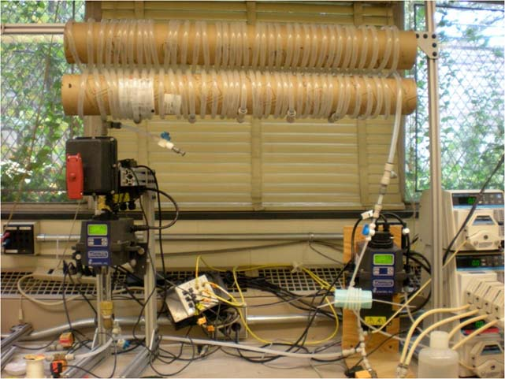
Coiled Tube Flocculation Residual Turbidity Analyzer
Dr. Karen Swetland Dissertation research
Notes:
Here we plotted the residual turbidity, the turbidity of the water after settling, against the coagulant dose. We noticed that when we used a log-log plot, there was a linear trend in the data. So we explored further.

Slide 21
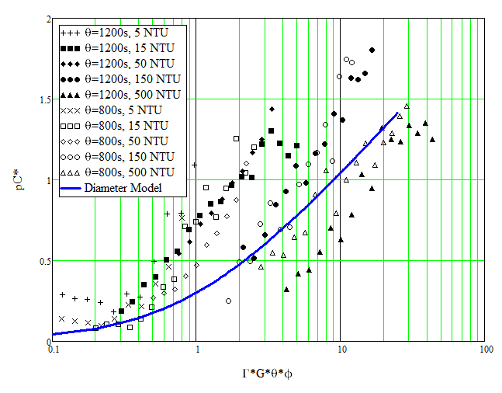
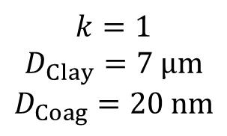
Diameter Scaling
$$k=1$$
$$D_{Clay}=7 μm$$
$$D_{Coag}=20 nm$$
Notes:
Analysis by William Pennock, 2016
This clay size may be larger than realistic and the nanoclusters may be smaller than what was produced by the granular PACl used by Karen.

Slide 22
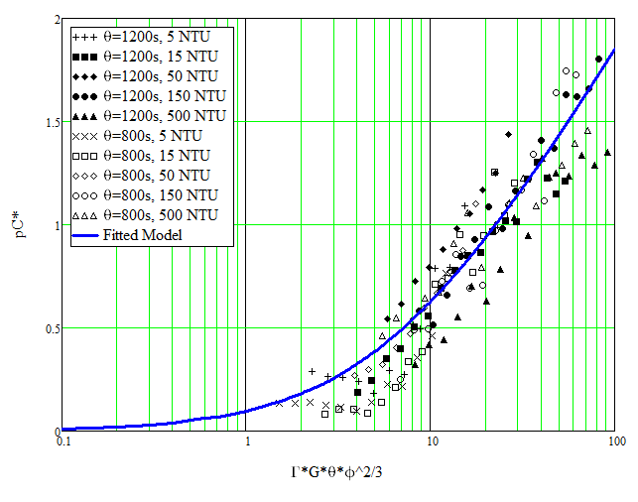
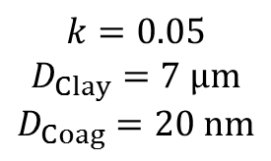
Separation Distance Scaling
$$k=0.05$$
$$D_{Clay}=7 μm$$
$$D_{Coag}=20 nm$$

Slide 23
Relative velocities appear to scale with average separation distance
These results appear to be different than classic particle collision models
There might be a confounding assumption that leads to these surprising results
Big flocs are useless
Small flocs disappear at a rate proportional to the number of their collisions
?

Slide 24
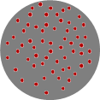
Floc model for viscous dominated collisions
Particle diameter
Fractional surface coverage of particle by coagulant
First order rate constant (model fitting parameter)
Flocculation time
Velocity gradient
Initial particle spacing

Slide 25
Model predictions?
Flocculator must be designed for target settled water turbidity

Slide 26
Predictions for required Gθ also suggest that Λ scaling is correct

Slide 27
4 major assumptions of the floc model
Transport velocity to a collision scales with the average separation distance of the particles
Relative velocities between particles are dominated by viscous shear (not inertia)
Separation distance is smaller than inner viscous scale
Collisions with large flocs don’t result in attachment
Plug flow!
Let’s explore these assumptions

Slide 28
Particle collisions appears to be dominated by viscous shear
inertial
viscous
Particle separation distances are less than the viscous length scale
Notes:
http://dimotakis.caltech.edu/pdf/Dimotakis_JFM2000.pdf (see equation 20 for factor of 50)
Assume clay size is 4 microm.
Rapid mix exploration.xmcd

Slide 29
Why might floc collision fail if the flocs are of very different sizes?
Tangent and rotational velocities cause shear and unzipping of bonds between particles of different sizes
Tangent velocity is proportional to the sum of the diameters of the particles
Flocs reach a terminal size based on a balance of the adhesive force of the bonds and the shear force that tends to tear them apart
Once a floc has reached its terminal size any further collisions are unsuccessful

Slide 30
Collision of two small flocs
Tangent velocities of the particles surfaces at collision is similar in magnitude to the normal velocity

Slide 31
Collision of a small floc with a large floc
Tangent velocities of the approaching particle surfaces increase as size of either particle increases
Bonds formed on impact are unzipped due to rotation and high tangent velocities (perhaps a maximum relative velocity?)

Slide 32
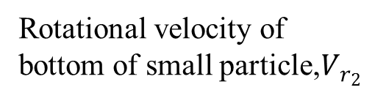
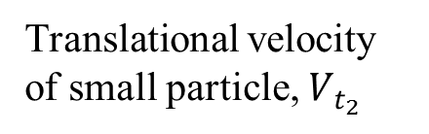
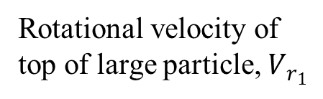
Collision of a small floc with a large floc
Translational velocity of small particle, $V_{t_{2}}$
Rotational velocity of top of large particle, $V_{r_{1}}$
Rotational velocity of bottom of small particle,$V_{r_{2}}$
2
1
Velocity gradient, G

Slide 33

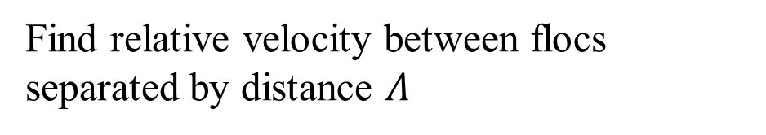


What does Gt mean?
y
y
velocity
Displacement in time t
$$v_{r}$$
$$Λ$$
u
x
$$L_{Deformation}$$
Definition of velocity gradient
Find relative velocity between flocs separated by distance $Λ$
The relative distance traveled due to fluid deformation is proportional to time
A Gt of 1 means that the particles have a relative displacement equal to their separation distance

